Slide 1
Content
SAP Overview
ABAP Dictionary/ Data Dictionary
ABAP Basics
Reports
Module Pool Programming
Layout Sets
Data Conversions
Modification and Enhancements
Connectivity
Notes:
First Slide

Slide 2
Content
Overview of Layout sets
SAP Scripts
Standard Text
Logo
Driver Program
Smartforms
Global Variables
Initialization
Templates
Tables
NACE configuration
Print Parameters
Notes:
First Slide

Slide 3
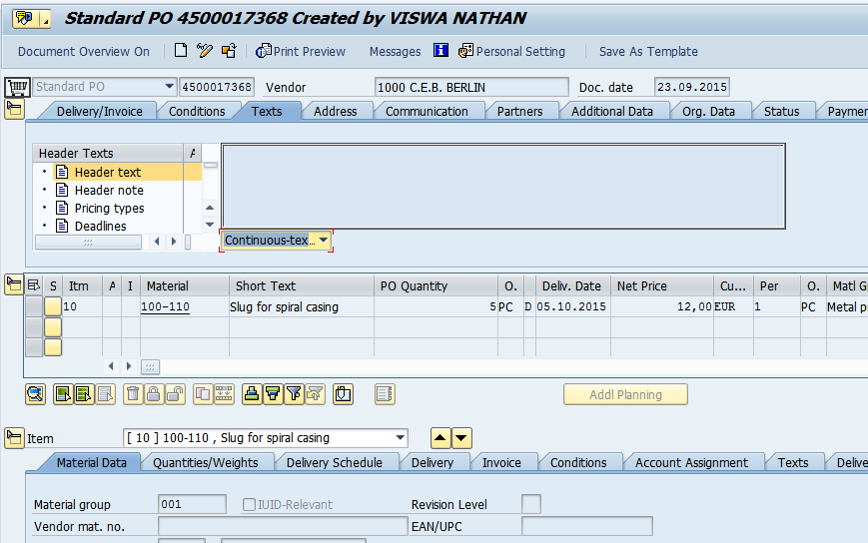
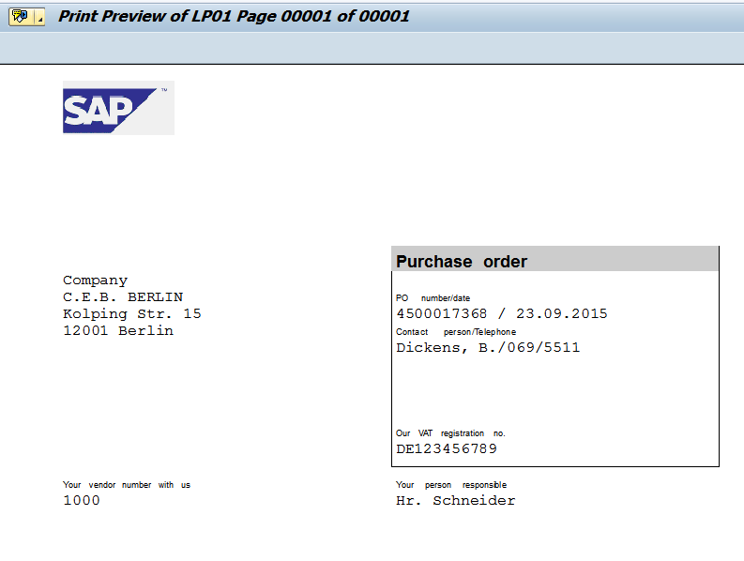
Layout Sets
Overview
Layouts are another kinds of applications to design layouts for business documents such
As Purchase Orders, Sales Orders etc.. For printing or sending via mail
Layout sets
Overview
Business document: Purchase Order
SAP Scripts
Driver Program
Smartforms
NACE Configuration
Print Parameters
Print preview of Purchase order . Data has been arranged in specific format in the print layout
Notes:
First Slide

Slide 4
Layout sets
Overview
Some of Transactions used to design Layout sets (SAP Scripts/Smartforms)
SE71 – SAP Script Design
SE72 - SAP Script Styles
SE73 – SAP Script Font Maintenance & Barcodes
SE78 – Logos
SO10 – Standard Text
SMARTFORMS – Smartform Design
SMARTSTYLES – Smartform styles
SE38 - Driver Program
Function Modules Used
Programs Used
Layout sets
Overview
SAP Scripts
Driver Program
Smartforms
NACE Configuration
Print Parameters
Notes:
First Slide

Slide 5
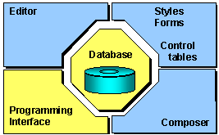
Layout Sets
SAP Script
Layout sets
SAP Script is a tool to design business documents layout such as purchase order, Delivery Notes, Invoice etc.
Components of SAP Scripts are
Layout Set
Symbols
Control Commands
Print Program/ Driver Program
Function Modules
Overview
SAP Scripts
Driver Program
Smartforms
NACE Configuration
Print Parameters
Steps:
Design SAP Script Layout
Develop Driver program to fetch data from
Database and call the designed layout
Notes:
First Slide

Slide 6
Layout Sets
SAP Script
Layout sets
Layout set is used to format the layout of SAP Script and format the text while printing
Overview
Layout Set
SAP Scripts
Driver Program
Header Data
Paragraph Format
Character Format
Layout
Smartforms
NACE Configuration
Print Parameters
Admin Data
Basic Settings
Page Format
Default Paragraph & Orientation
Notes:
First Slide

Slide 7
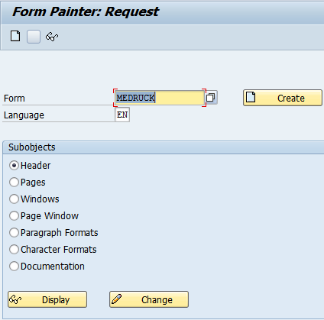
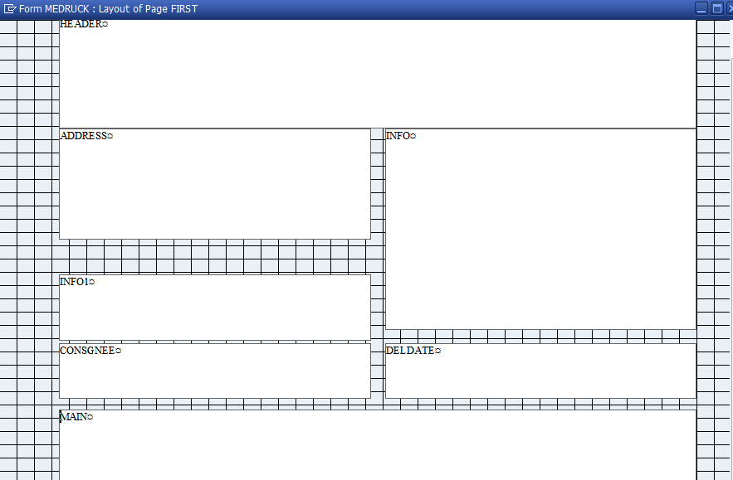
Layout Sets
SAP Script
Initial Screen of SAP Script
Layout sets
SE71 – Form Painter. There are different types of sub objects in SAP Script
Overview
SAP Scripts
Driver Program
Smartforms
NACE Configuration
Print Parameters
We will design the form by adding several output areas called window. And each output area contains values to be displayed
Notes:
First Slide

Slide 8
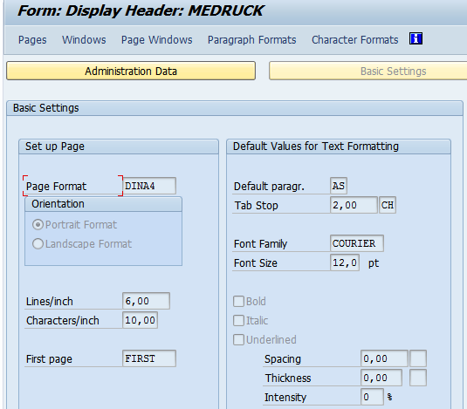
Layout Sets
SAP Script
Header Data:
Layout sets
It contains two Parts
Administrative Data
Basic Data
Admin Data contains general details
Such as
Description
Package
Language of the form
Package etc.
In the Basic data we will specify
Page Format
Orientation
Lines per inch
Characters per inch
First Page to be displayed
Default Paragraph
Default Font family & Size etc
Overview
SAP Scripts
Driver Program
Smartforms
NACE Configuration
Print Parameters
Notes:
First Slide

Slide 9
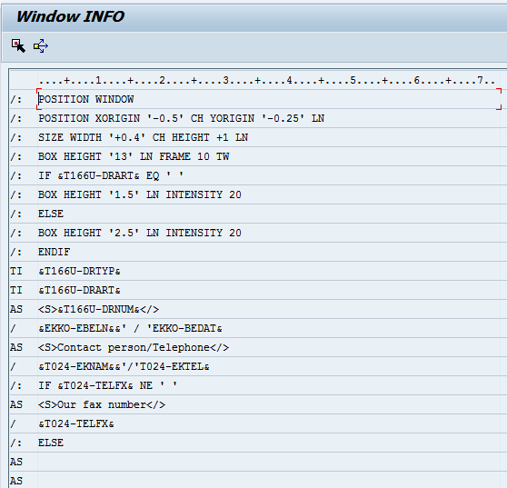
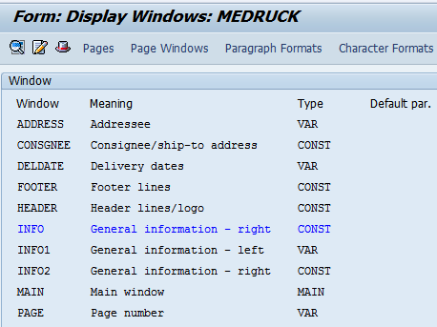
Layout Sets
SAP Script
Windows & Text Elements:
Window is an output area where system prints some data and is positioned on a page. There are different types of windows
Main Window
Variable Window
Constant Window
Layout sets
Overview
SAP Scripts
Driver Program
Control Command Area: Specify command or Paragraph format
Smartforms
NACE Configuration
Print Parameters
Windows/Output areas defined in the form
Actual Content in the window
Notes:
First Slide

Slide 10
Layout Sets
SAP Script
Main Window
It is an output are where system prints the Continuous text. i.e. if the main window filled
With the text then remaining text will not be truncated . Remaining text will be displayed
In the main window of next page and so on as long as there is a next page available with
Main window
You can create up to 99 Main windows per page and all the main windows width should
Be same
Variable Window
It is an output area where system will prints some data. if the variable window filled
With the text then the remaining text will be truncated and will not be extended to the
Variable window of next page. It is used to display fixed number of lines on to it
Constant Window
It is an output area where system displays constant values
Layout sets
Overview
SAP Scripts Basics
Driver Program
Smartforms
NACE Configuration
Print Parameters
Notes:
First Slide

Slide 11

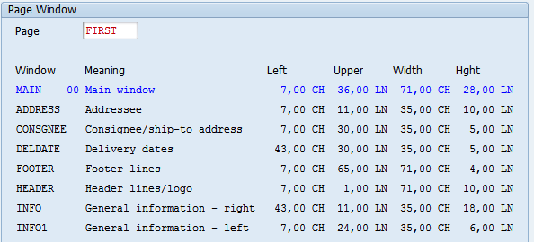
Layout Sets
SAP Script
Layout sets
Pages:
Page is the place holder of windows. Based on the requirement we will create
One or more number of pages
Overview
SAP Scripts
Driver Program
Smartforms
Page Windows: it defines the position, width and Height of the each window on the page
NACE Configuration
Print Parameters
Notes:
First Slide

Slide 12
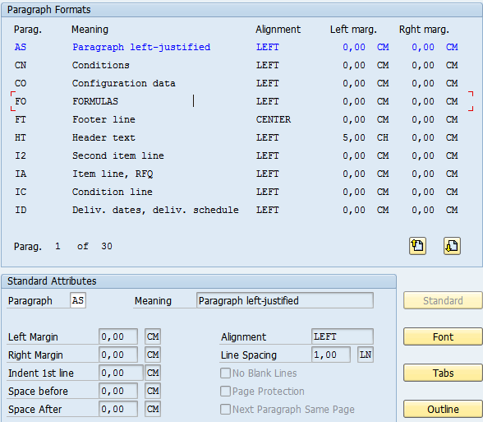
Layout Sets
SAP Script
Layout sets
Paragraph Format: It is used to format the lines of text of a paragraph
Overview
In each paragraph we will specify
Paragraph format name
Standard Attributes
Margins
Alignment
Spaces before & After of line
Line Spacing
Font
Font Family
Size & Bold, Italic etc.
Tabs: Position of text
Outline
Outline details
Delimiters
Numbering types
SAP Scripts
Driver Program
Smartforms
NACE Configuration
Print Parameters
Notes:
First Slide

Slide 13
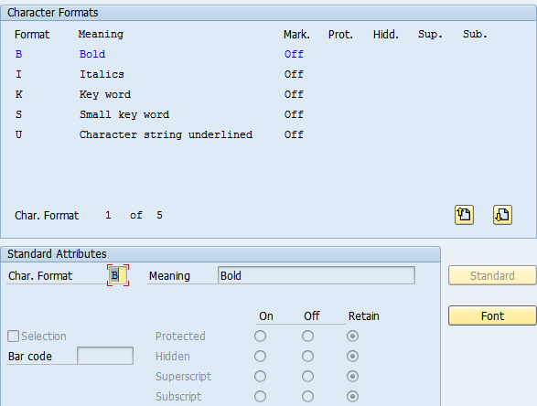
Layout Sets
SAP Script
Layout sets
Character formats
Character formats are used to alter the format of the part of text with in the paragraph format
Overview
SAP Scripts
In each character format we will specify
Character format name
Standard Attributes
Description
Barcode
Subscript or super script
Font
Font Family
Size & Bold, Italic etc.
Driver Program
Smartforms
NACE Configuration
Print Parameters
Notes:
First Slide

Slide 14
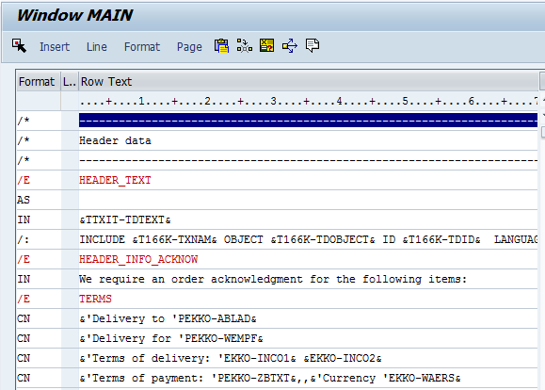
Layout Sets
SAP Script
Layout sets
Text Editor
It is the actual place where we will specify text/logos to be displayed on the print out. It is having two parts
Format Specifies
Row Text
Overview
SAP Scripts
In the format section we will
Specify following
Paragraph format
Control Command
In the Row text we will specify following
Static text
Text symbols
Character format specification
Tab Specification
Text Modules
LOGOs
Driver Program
Smartforms
NACE Configuration
Print Parameters
Notes:
First Slide

Slide 15
Layout Sets
SAP Script
Layout sets
Steps to create Script
Create Script using SE71
Create Pages
Create Paragraph Formats
Create Character formats
Create Windows
Add text to Windows
Create Page windows
Overview
SAP Scripts
Driver Program
Smartforms
NACE Configuration
Print Parameters
Notes:
First Slide

Slide 16
Layout Sets
SAP Script
Layout sets
Symbols:
Symbols are place holders which contains value at the time of printing. Symbol is
identified by the name surrounded by ‘&’
Example: Name = ‘SAP ABAP’ in the program. We will use in the Script as below
&Name&
Types of Symbols
System Symbols
Standard Symbols
Program Symbols
Text Symbols
System Symbols: These are provided by the SAP
Ex: &Date&, &time& etc.
Standard Symbols:
These are maintained in table TTDTG with name and their value
Ex: &MFG& - Kind Regards
&SGDH& - Dear Sir/Madam
Overview
SAP Scripts
Driver Program
Smartforms
NACE Configuration
Print Parameters
Notes:
First Slide

Slide 17
Layout Sets
SAP Script
Layout sets
Program Symbols:
These are global variables declared in Print Program that are transferred to the SAP Script
Ex:
&LFA1-LIFNR&
&WA_EKKO-EBELN&
Text Symbols:
Text symbols are variables defined in the SAP Scripts and processed in the SAP Script only
Syntax:
/: Define &text1& = ‘Hyderabad’
Define is the control command used to declare variables in the SAP Script
Control Commands:
it is used to format or process the text while printing there are different control commands
Ex:
/: IF..ENDIF
/: CASE..ENDCASE
/: ADDRESS..ENDADDRESS
/: PROTECT..ENDPROTECT
Overview
SAP Scripts
Driver Program
Smartforms
NACE Configuration
Print Parameters
Notes:
First Slide

Slide 18
Layout Sets
SAP Script
Layout sets
Format Key Or Tag Column
It defines the output formatting of the text or provide the control command.
* (Star)- Default paragraph
/ (Slash) – Subsequent text will be printed in a new line during output printing
/: (Control Command) – it control command the text provided in the line will not be printed as it is instead it is regarded as control command
/* (Comment Line) – text is ignored while printing
= (Extended line) – text on this line will be appended to the preceding line
/= (Similar to Extended line) – the subsequent text will be placed in the new line while printing
/E (Text element) Grouping logically related text
/: BOX HEIGHT <> CM WIDTH <> CM FRAME <> TW it is used to display box
Overview
SAP Scripts
Driver Program
Smartforms
NACE Configuration
Print Parameters
Notes:
First Slide

Slide 19
Layout Sets
SAP Script
Print Program or Driver Program
It is an program which collects the data from the database and transfers it to the SAP Script
Function Modules:
A print program contains number of function modules. They are
OPEN_FORM: it will open the SAP SCRIPT
START_FORM: it will start the form from a particular page onwards
END_FORM: it will end the functionality of START_FORM
WRITE_FORM: it will write text on to the Window
CONTROL_FORM: It will trigger explicit Page Breaks
CLOSE_FORM: It will close the form processing
Layout sets
Overview
SAP Scripts
Driver Program
Smartforms
NACE Configuration
Print Parameters
Notes:
First Slide

Slide 20
Layout Sets
SAP Script
LOGO
There are two ways to upload logo or Image to SAP R/3 system
RSTXLDMC – to upload image of TIFF (Tag Information Format)
SE78 – Upload Bitmap Image
Layout sets
Overview
SAP Scripts
Driver Program
Smartforms
NACE Configuration
Print Parameters
Notes:
First Slide

Slide 21
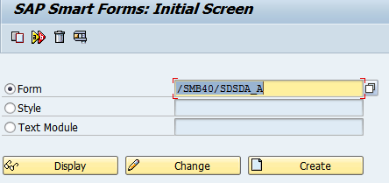
Layout Sets
Smartforms
Smartform is an concept of text management system which is used to design the print layout for business documents such as invoice, sales order etc.
Features
Smartforms is easy to design
Text element independent
Language Independent
Data Can be displayed in tabular format
Smartform having interface parameters
Only one main window is created in smartforms
Boxes and Coloring is very easy
A function module will be generated once we activate the Smartform
Layout sets
Overview
SAP Scripts
Driver Program
Smartforms
NACE Configuration
Print Parameters
Transactions: SMARTFORMS
Notes:
First Slide

Slide 22
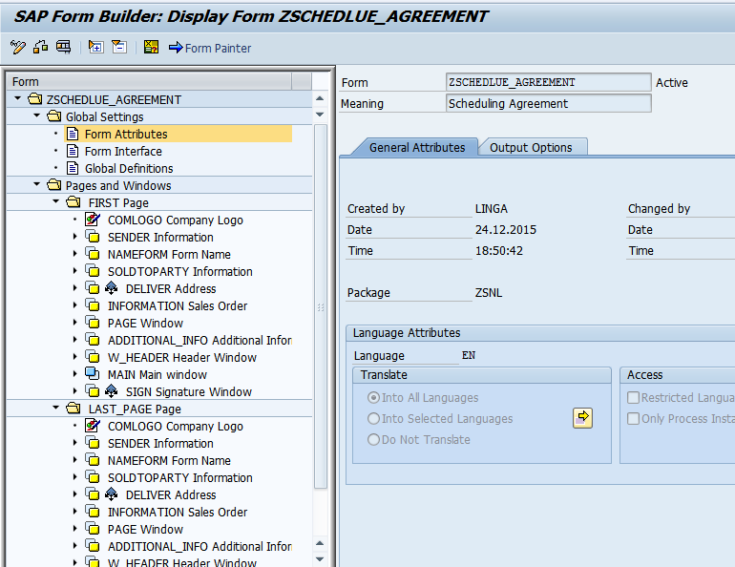
Layout Sets
Smartforms
Left Navigation Pane
Global Attributes
Pages & Windows
Layout sets
Overview
SAP Scripts
Driver Program
Smartforms
NACE Configuration
Print Parameters
Work area where we can modify individual node
Notes:
First Slide

Slide 23
Layout Sets
Smartforms
Layout sets
Smartform is an concept of text management system which is used to design the print layout for business documents such as invoice, sales order etc.
Components of Smartform
Global Settings
Form Attribute
Form Interface
Global Definitions
Pages & Windows
Form Attribute:
It contains Translation details, Smartstyle details & Page format etc
Form Interface:
It is used to pass the data to and from smartforms which contains the options such as import, export, tables & exceptions etc. We can send data from driver program to smartform
Global Definitions:
It is used to define data types & declare variables globally so that they can be used throughout the smartforms
Overview
SAP Scripts
Driver Program
Smartforms
NACE Configuration
Print Parameters
Notes:
First Slide

Slide 24
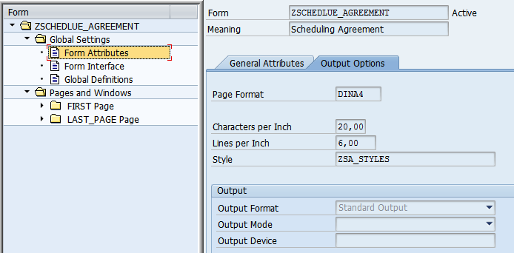
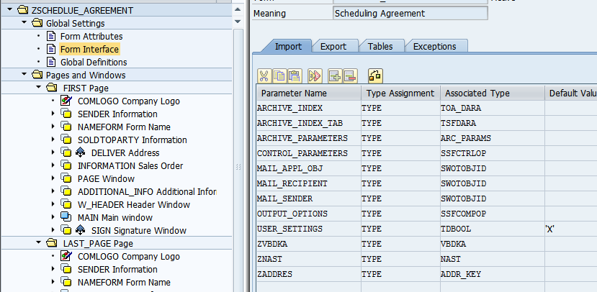
Layout Sets
Smartforms
Form Attributes
Layout sets
Overview
SAP Scripts
Driver Program
Smartforms
Form Interface
NACE Configuration
Print Parameters
Notes:
First Slide

Slide 25
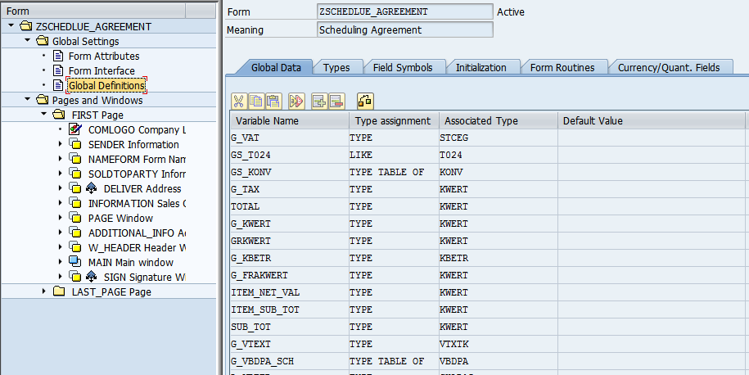
Layout Sets
Smartforms
Global Definitions
Layout sets
Overview
SAP Scripts
Driver Program
Smartforms
NACE Configuration
Print Parameters
In the Global definitions, we can
Declare variables, Types, & Field symbols.
Write piece of code which will be executed initially
Write logic in the subroutines which will be called with in the smartforms
Notes:
First Slide

Slide 26
Layout Sets
Smartforms
Types of Windows
There are 4 types of Windows
Main Window
Secondary Window
Copy Window
Final Window
Main Window
It is an output area where continues text is displayed. If the main window is filled with the text then the remaining text will not be truncated instead it will be displayed in the main window of the next page and so on as long as the next page with main window is available
Secondary Window
It is an output area where fixed number of lines of text is displayed. If the secondary window is filled with the text then remaining text will be truncated as the secondary window will not be extended to the next page
Copy Window
It is an output area where copies of text will be displayed such as Original Copy, Duplicate copy, Triple copy etc.
Final Window
It will be executed at the end of all the execution of windows of smartforms
Layout sets
Overview
SAP Scripts
Driver Program
Smartforms
NACE Configuration
Print Parameters
Notes:
First Slide

Slide 27
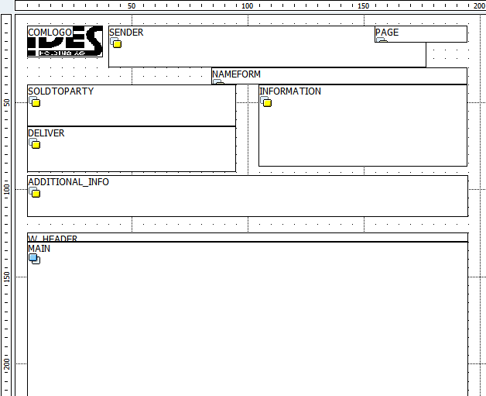
Layout Sets
Smartforms
Example Layout and Windows placement
Layout sets
Overview
SAP Scripts
Driver Program
Smartforms
NACE Configuration
Print Parameters
Notes:
First Slide

Slide 28
Layout Sets
Smartforms
Types of Nodes in Smartforms
Text Node: Used to display text
Address Node: Special node to handle Address format
Graphic Node: Special node to handle logo
Program Lines Node: Used to write some piece of code
Alternative Node: Used to Specify IF condition
Loop Node: Used to specify LOOP & ENDLOOP
Command Node: Used to trigger explicit page break
Table Node: Special Node to handle Internal table. Similar to LOOP but having additional features
Template Node: Used to design and place text nodes in box formats
Folder Node: Used to combine other nodes
Layout sets
Overview
SAP Scripts
Driver Program
Smartforms
NACE Configuration
Print Parameters
Notes:
First Slide

Slide 29
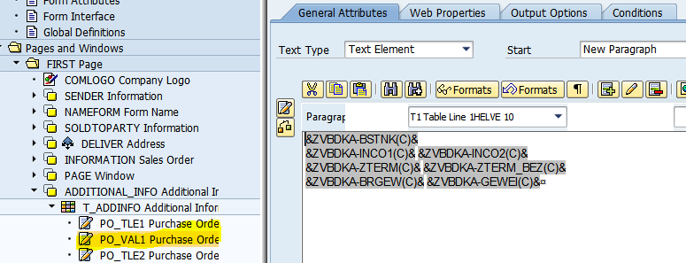
Layout Sets
Smartforms
Text Node: Specify variables
Layout sets
Overview
SAP Scripts
Driver Program
Smartforms
NACE Configuration
Print Parameters
Notes:
First Slide

Slide 30
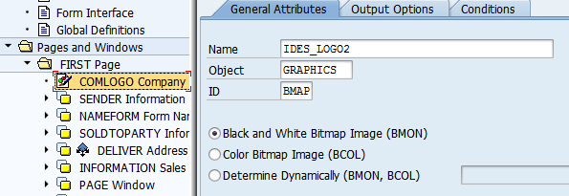
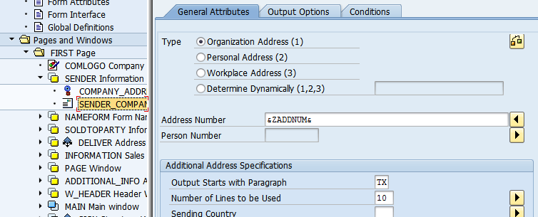
Layout Sets
Smartforms
Logo Node: Specify logo Id and other details
Layout sets
Overview
SAP Scripts
Driver Program
Smartforms
Address Node: Specify Address Number
NACE Configuration
Print Parameters
Notes:
First Slide

Slide 31
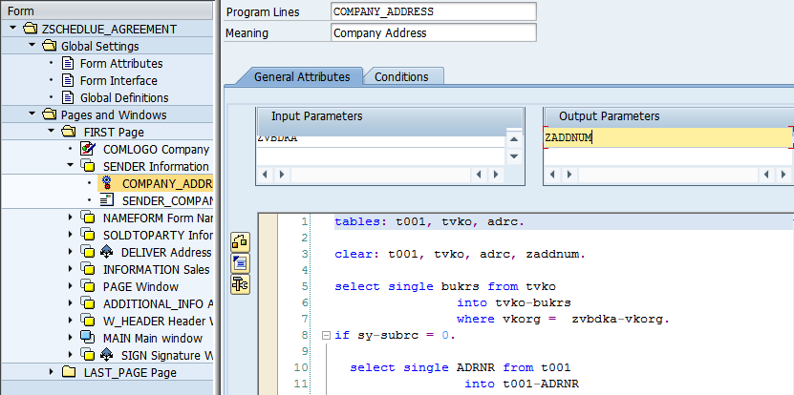
Layout Sets
Smartforms
Program Lines Node
Layout sets
Overview
SAP Scripts
Driver Program
Smartforms
NACE Configuration
Print Parameters
Notes:
First Slide

